Slide 1
Durban Market Analysis
Analytics Alchemy
15 May 2024
Onalenna Magoro
Pfumelani Shibonze
Mongezi Chibi
Mohamed Rasool
Percival Shimange

Slide 2
Introduction
Durban Fresh Produce Market functions as a commission market and welcomes all fresh produce farmers/suppliers to market their produce through one or more of their 6 market agents. Market agents sell produce on behalf of farmers and suppliers and receive a mutually negotiated commission.
About Dataset :
From December 2019 to October 2020
64337 observations and 13 columns such as Regions(22),commodities(270), total quantity sold and sales total
Contains commodities ( fruits and Veg) that are produced from different south african and african regions
Data Cleaning :
Exploring the data
Removed rows containing missing values
Feature engineering (adding selling price and date columns)

Slide 3
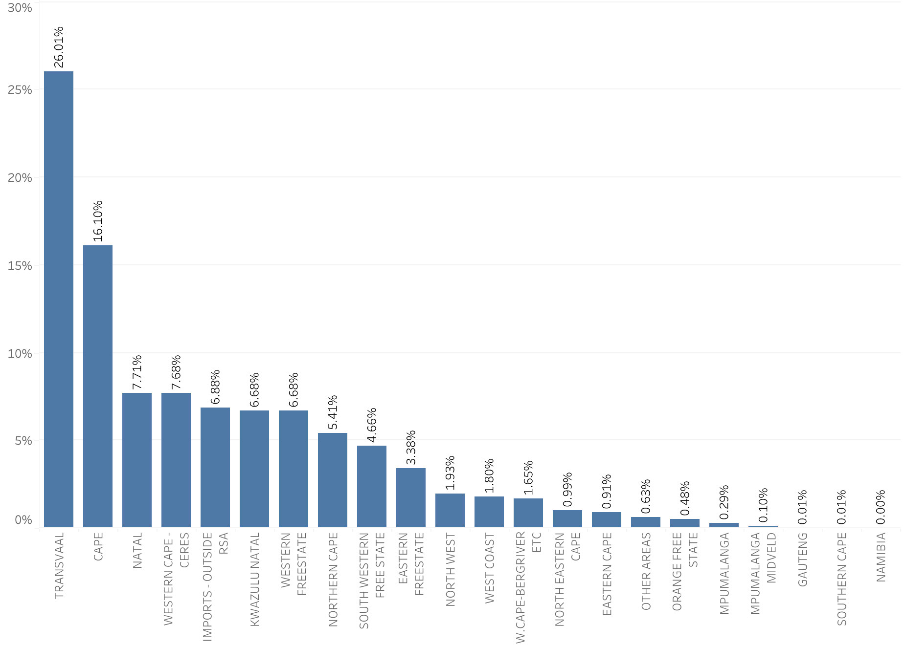
Market Share Per Region

Slide 4
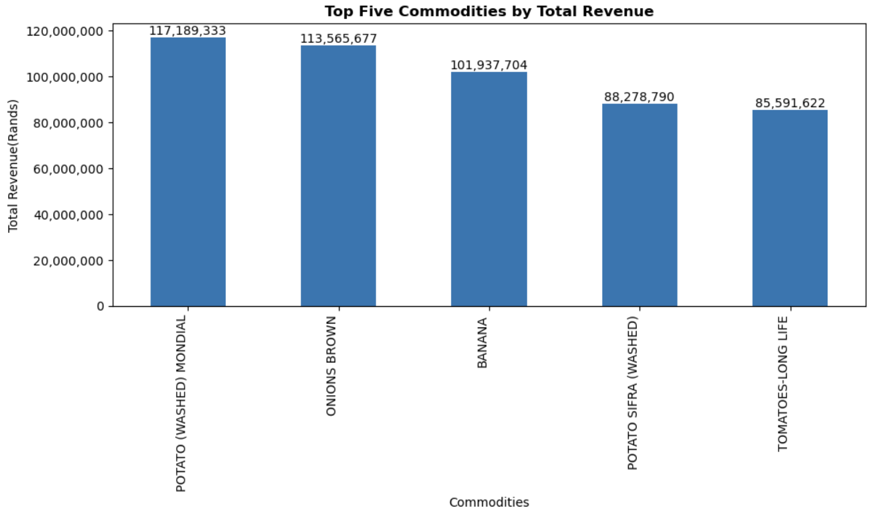
Top Commodities by Total Revenue

Slide 5
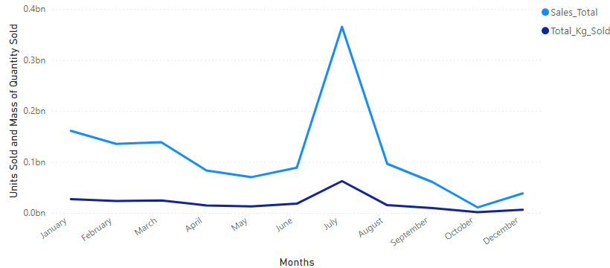
Total Sales And Total Kilograms Sold Over The Months

Slide 6
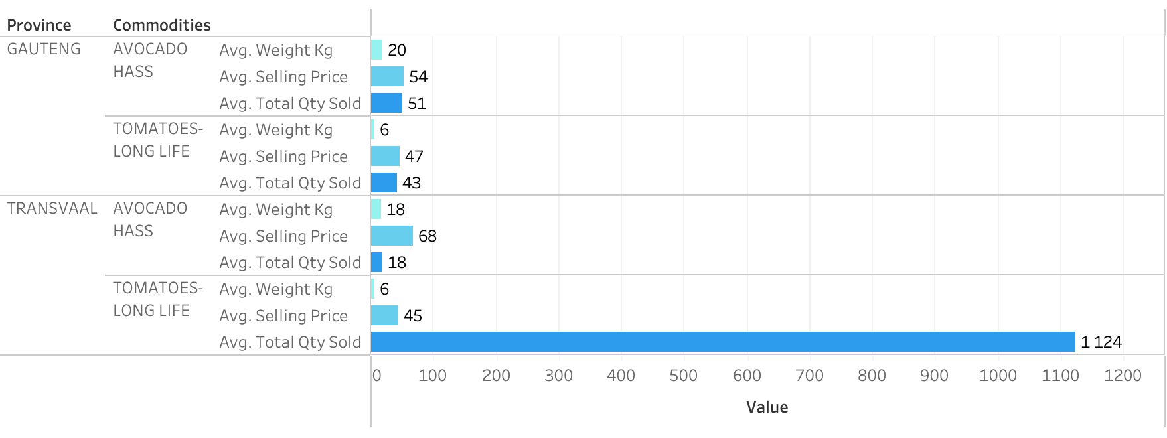
Price Comparison Of The Top and Lower Performing Region Using Common Commodities

Slide 7
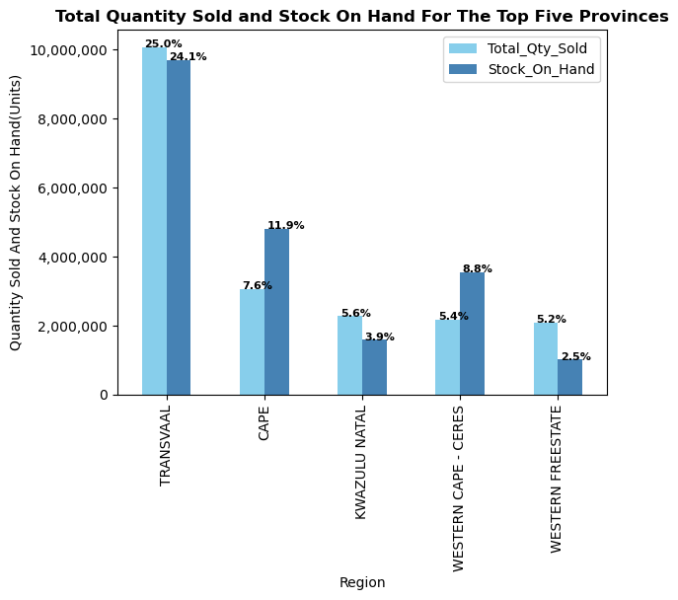
Total Quantity Sold And Stock On Hand For The Top Five Regions

Slide 8
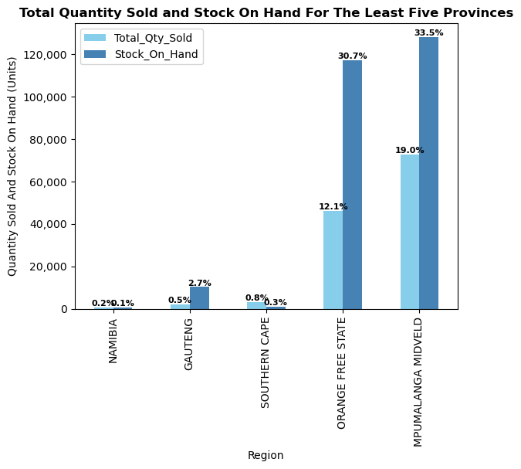
Total Quantity Sold And Stock On Hand For The Least Five Regions

Slide 9
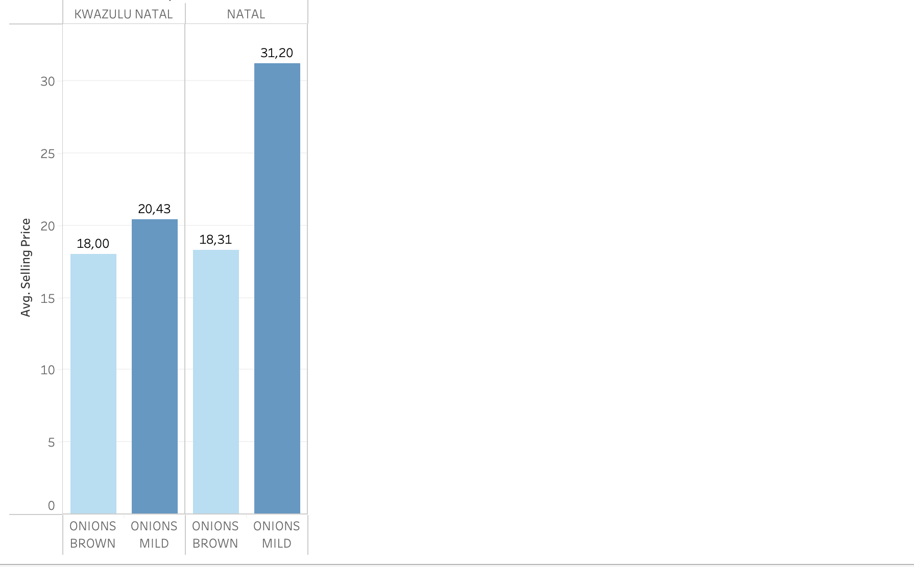
Price Comparison Kwazulu Natal and Natal province Using Common Commodities

Slide 10
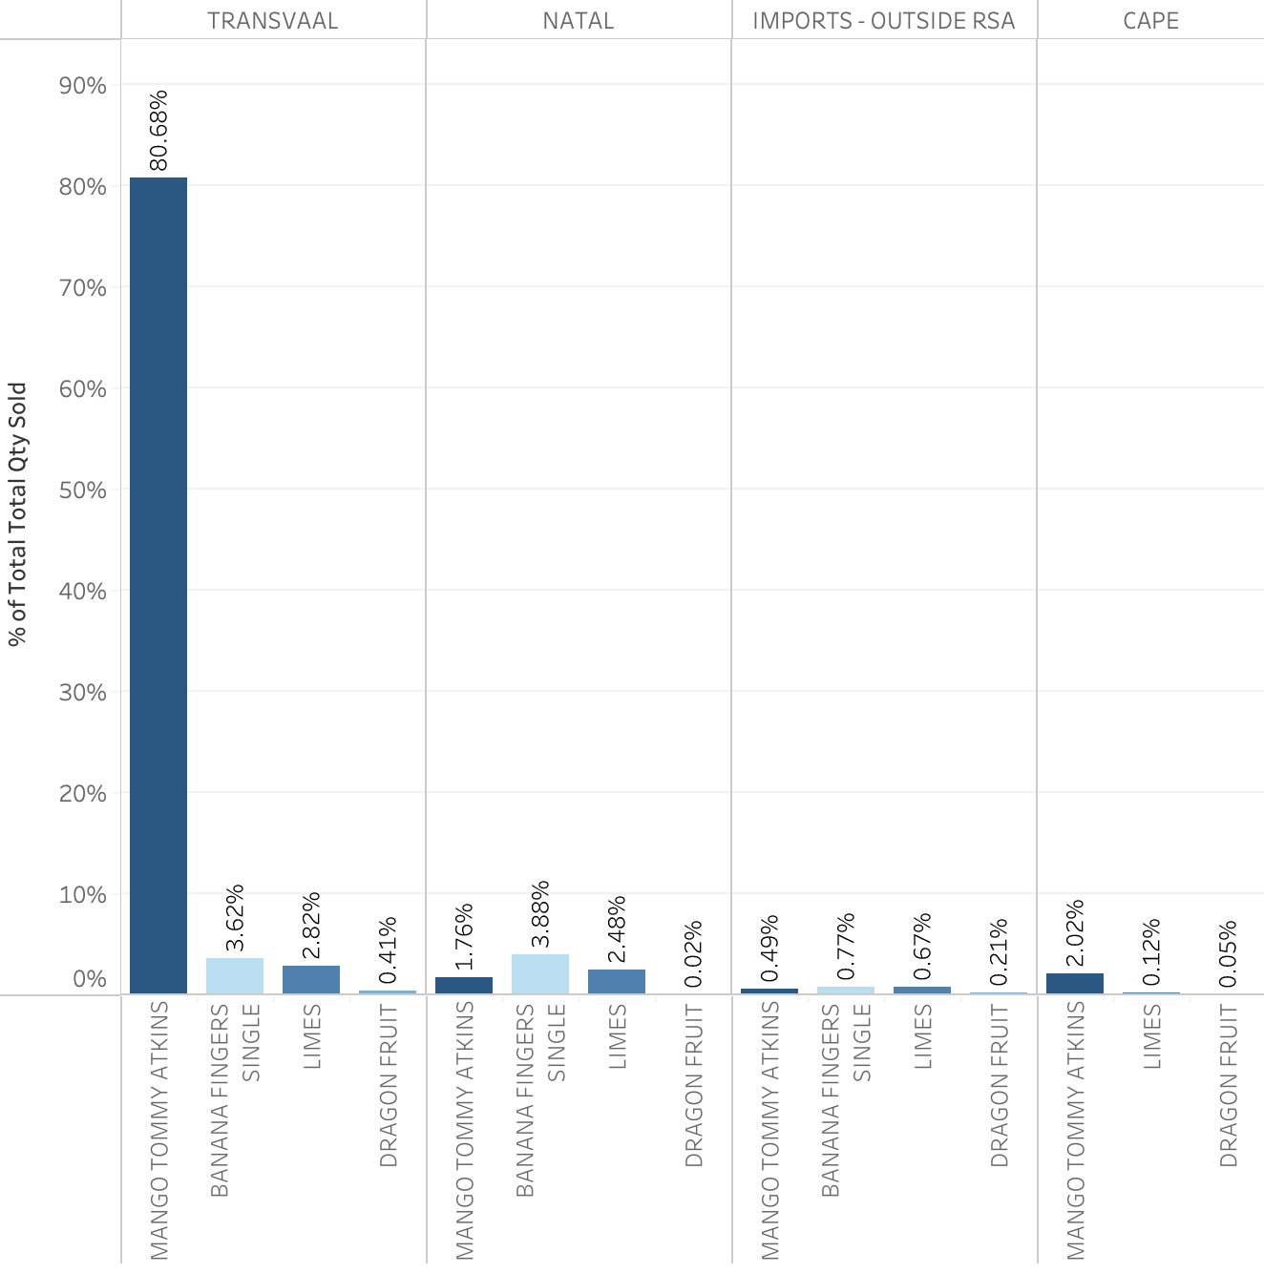
Percentage Of Common Commodities Sold, Imported and Produced in South African Region

Slide 11
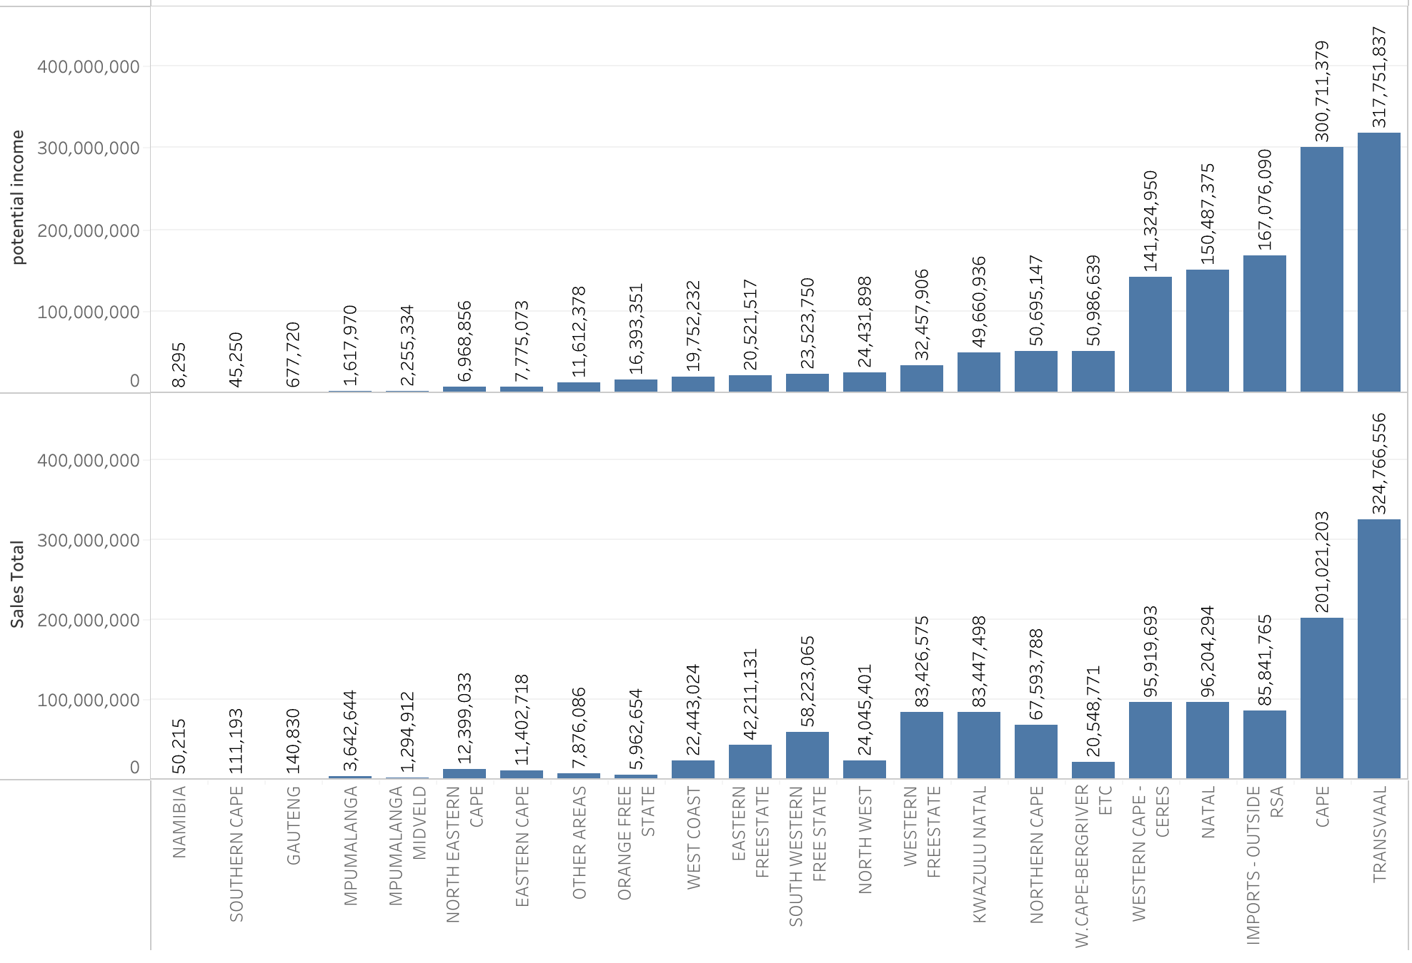
Total Sales And Potential Income By Region

Slide 12
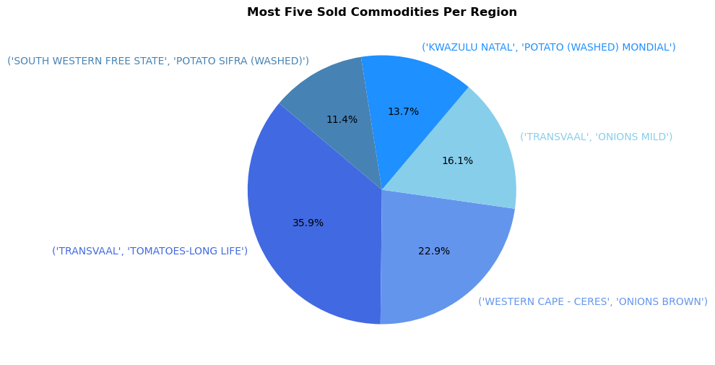
Most Five Sold Commodities Per Region

Slide 13
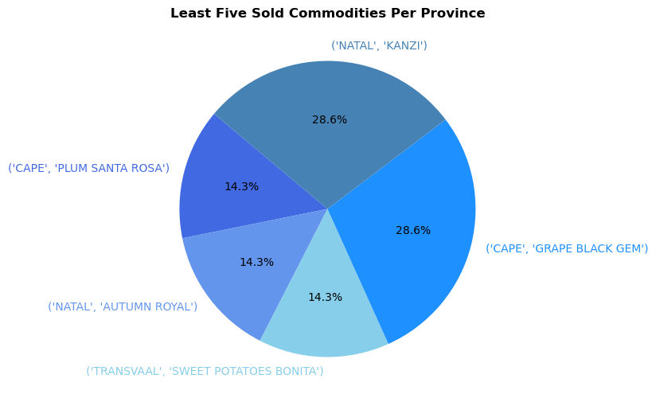
Least Five Sold Commodities Per Region

Slide 14
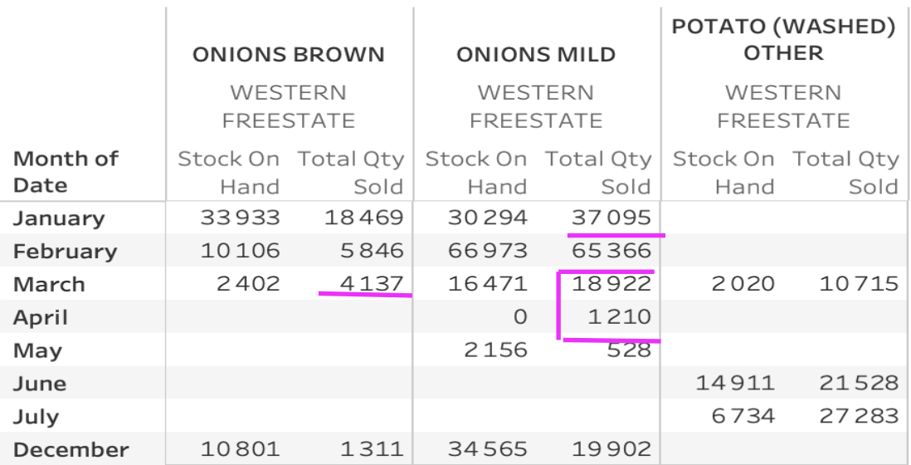
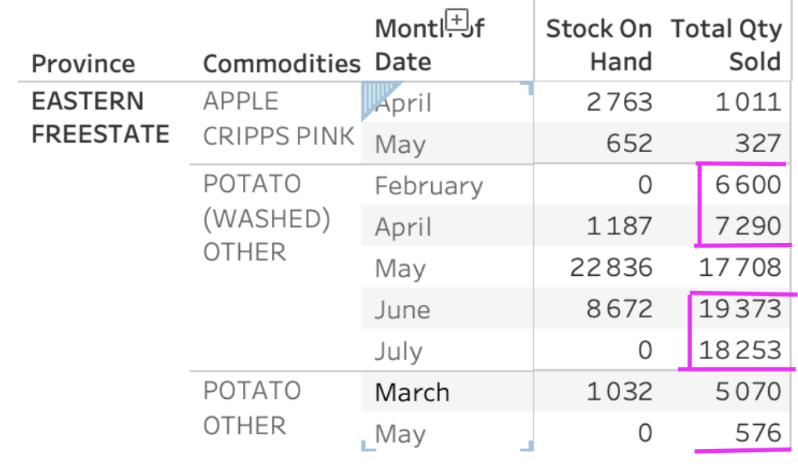
Stock On Hand And Total Quantity Sold Per Month In Western and Eastern Free State

Slide 15
Insights
Transvaal has the highest Market share which means commodities from Transvaal are making more sales in comparison to the others. Despite it having a high stock on hand, there is no pressure to sell commodities in Transvaal because it is leading in sales( quantity sold) and profit. One of the highest sold commodity is tomato-long life which is a summer crop and thrives in warm and dry conditions. Transvaal is known for having warm weather temperatures. These tomatoes are preferred by customers as they retain their colour, size and flavour longer than other tomatoes.
The top profitable commodities amongst others are potato(washed) mondial, brown onions, bananas and tomato-long life.potato mondial are more preferred by producers as they only take 90 days to grow and customers prefer because they are good for making variety of home made recipes such as potato.-salad They stay firm when boiled and do not easily break.Durban Market should consider increasing prices of this because they are not price sensitive.
There is a consistency in stock sold in kg from january to may and this is before harvest season and the commodities that are being sold during this periods are those that do not move the market such as sweet potatoes and autumn royal (least sold commodities)
Comparison between common commodities produced in south africa and commodities imported shows that all South african commodities are relatively competitive meaning commodities from south africa are selling more than those being imported.

Slide 16
Continuation of Insights
The comparison of common commodities between Transvaal(with the highest Market share) and Gauteng (least market share) shows that price sensitivity and the law of demand- which states the lower the price the higher the demand. Customer will always go for goods that are rather low when it comes to certain goods
The total sales and potential income by region shows that some region can make more profit(potential income) than the what they are making currently(total sales) if they consider using lower prices when they sell their stock on hand. E.g gauteng can make R 536 890 more than the current sales
The top five sold quantity gives a reflection of which commodities are being sold in the market and the least sold commodities with this we can do recommendation in terms of which commodities should Durban Market order the most
Stock on hand and total quantity sold per month in Eastern and Western Free State shows the highest stock on hand in the region and the month that they sell more than what they have on hand. In March they sold more brown onions than what they have on hand this reflects that march is a good month to stock up on brown onions and the other months they should stock less of brown onions to prevent losses as this is a perishable commodities

Slide 17
THANK YOU, ENJOY YOUR DAY

